Slide 1
When in need(WIN)
Team members:
Roopa Hs
VIBHa
SUbBAIAH

Slide 2
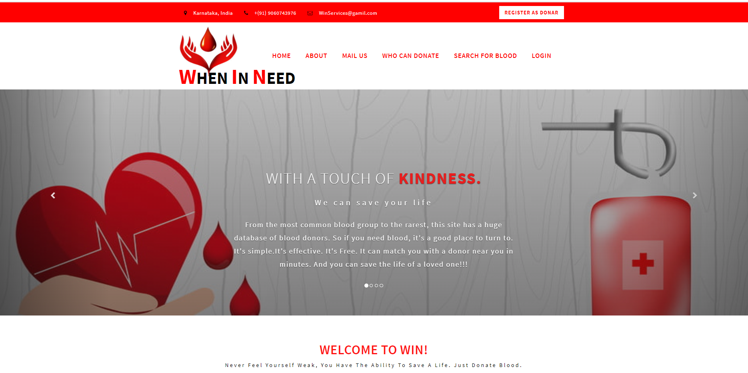
Home Page

Slide 3
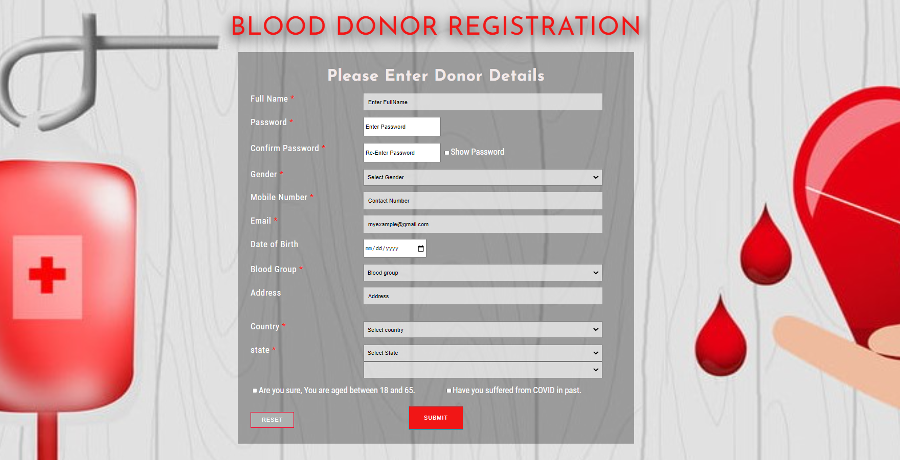
Donor Registration page

Slide 4
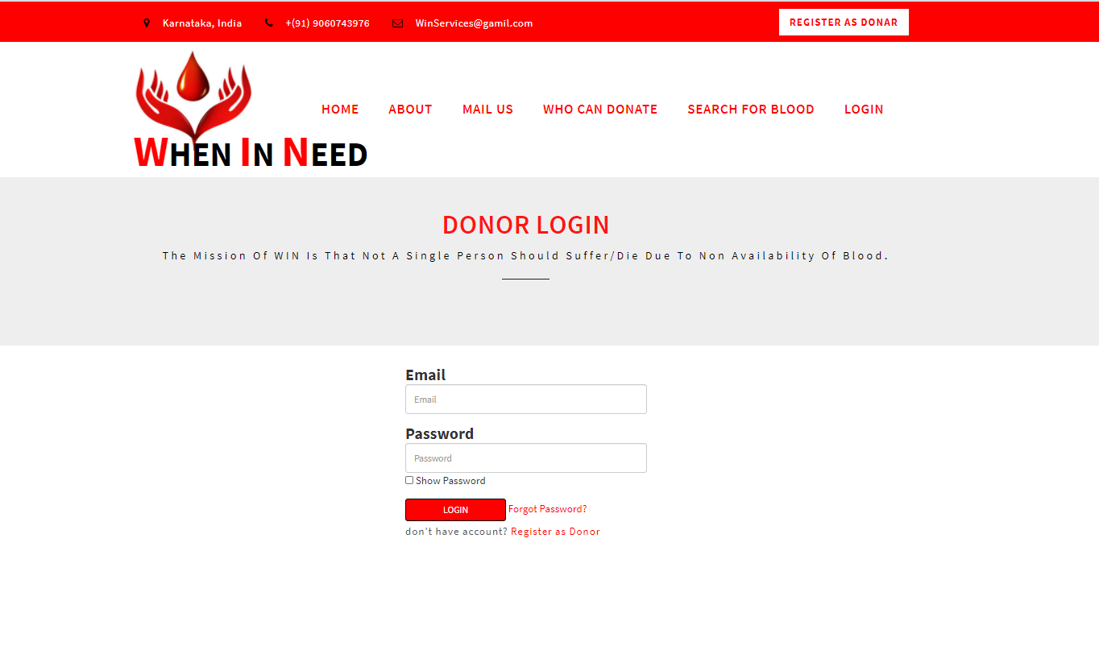
Login

Slide 5
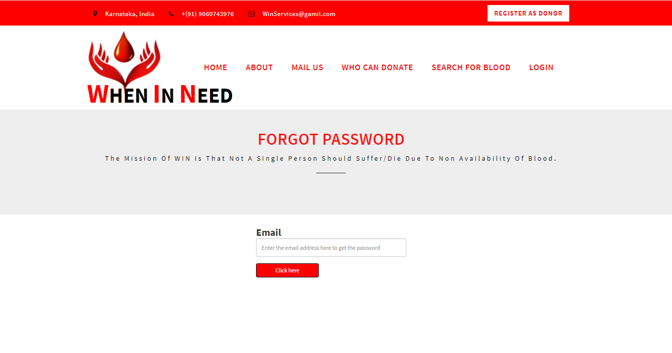
If the user forgot the password

Slide 6
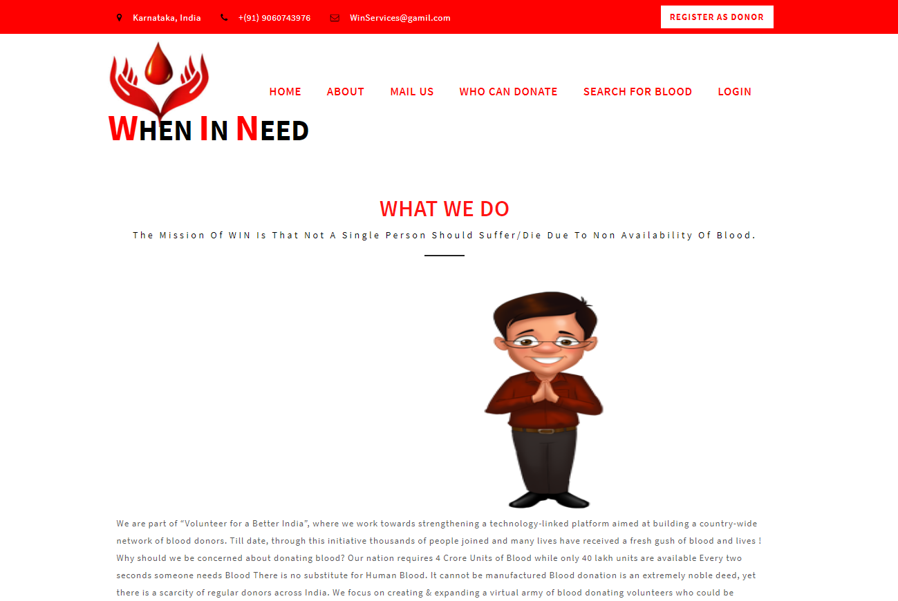
About us

Slide 7
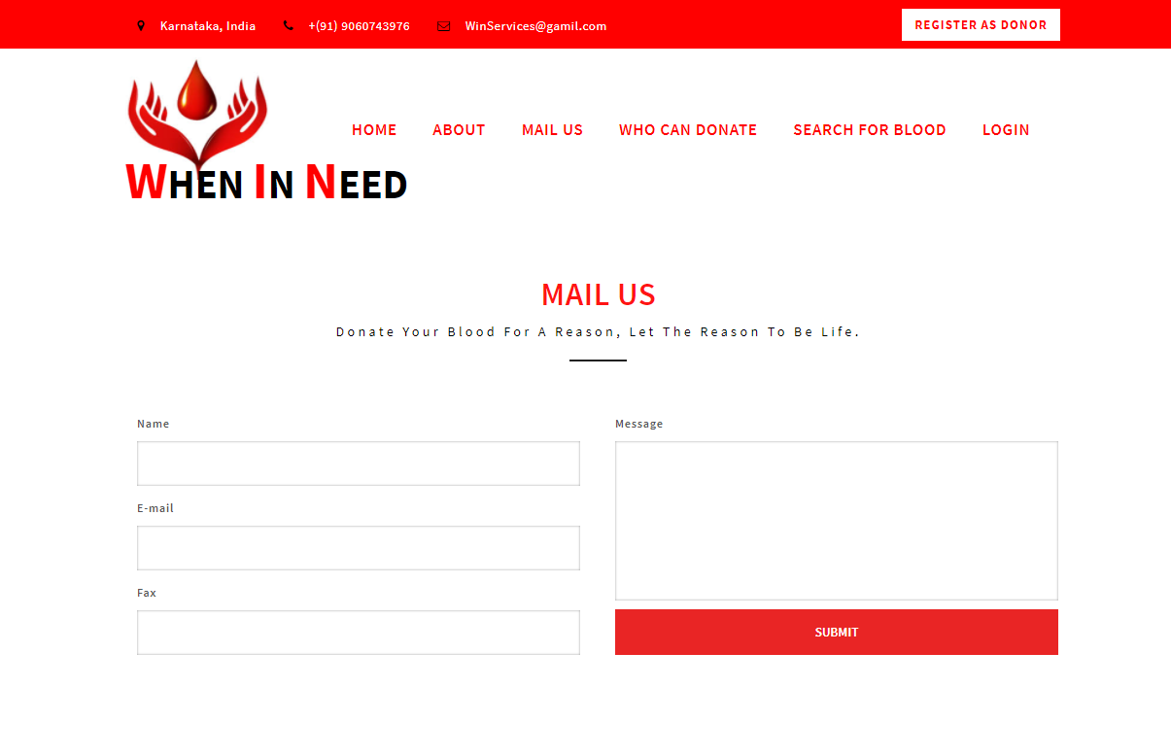
Mail us

Slide 8
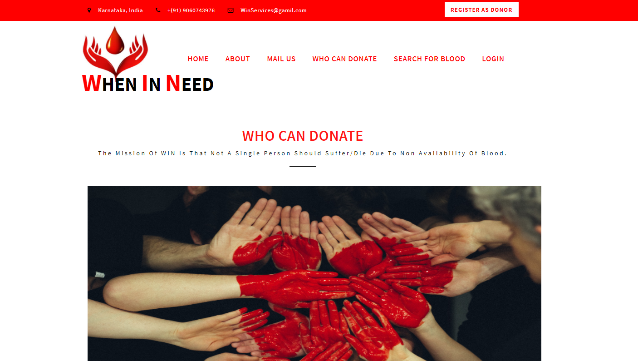
Who can donate the blood and who should not?

Slide 9
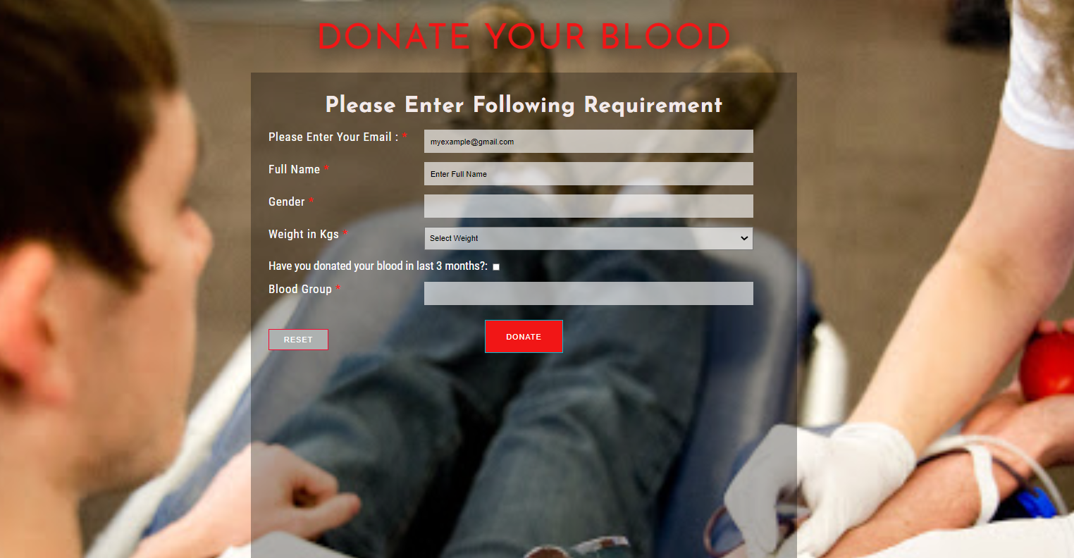
Donate blood

Slide 10
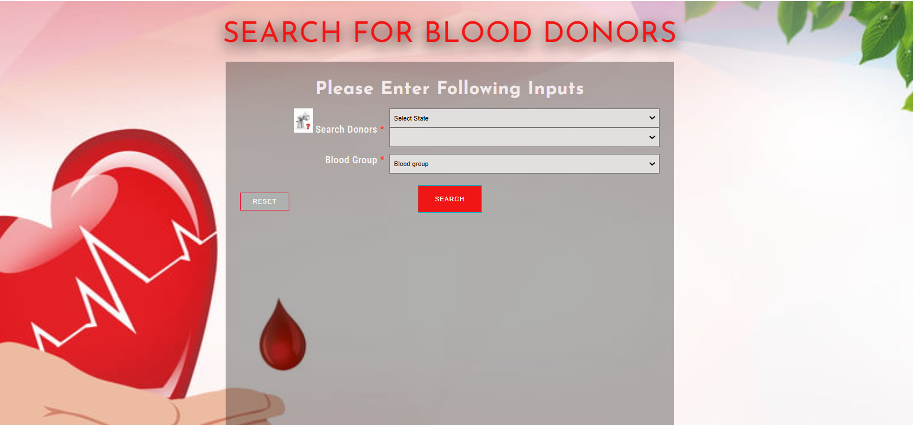
Search for donors

Slide 11
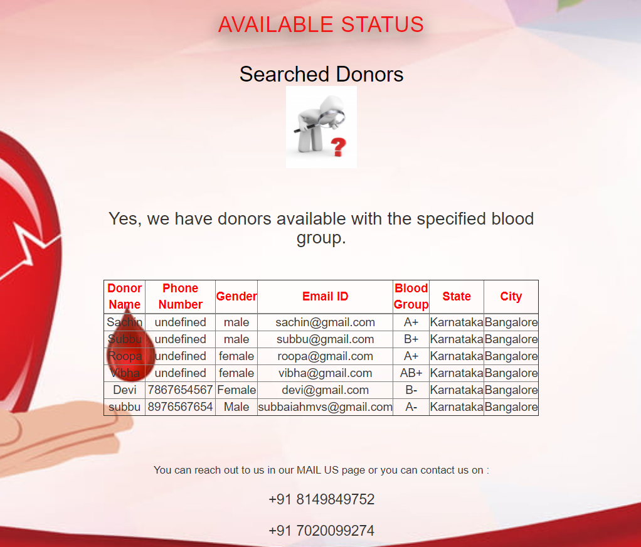
Available Donors

Slide 12
Thank you

